Slide 1




HackOrbit 2025
Team Name: Psychic Coders
Theme: Open Innovation

Slide 2

THEME : Open Innovation
PROBLEM STATEMENT :
Rural India frequently faces natural disasters like floods, cyclones, and earthquakes. However, relief coordination in these areas remains a critical issue. Poor communication and lack of real-time data sharing among NGOs, local volunteers, and government agencies lead to:
Duplication of aid – Some areas receive excessive supplies while others are neglected.
Delays in relief – No real-time updates on needs and available resources.
Underutilization of local volunteers – No platform to engage local communities effectively.
While urban areas have access to tech solutions like BBMP Sahaaya, rural India still lacks a decentralized, tech-based coordination system.

Slide 3

PROPOSED SOLUTION : ReliefNet
A decentralized web app designed for rural disaster management that enables real-time coordination between local volunteers, NGOs, and relief agencies.
Key Modules:
Report Needs – Villagers or local volunteers can report needs like water, food, or shelter.
Resource Sharing – NGOs can post available supplies like blankets, medicines, or food kits.
Community Voting – Needs can be prioritized based on local votes to ensure urgency-based aid delivery.
Volunteer Matching – Local people can sign up and be matched to relief tasks in their area.

Slide 4
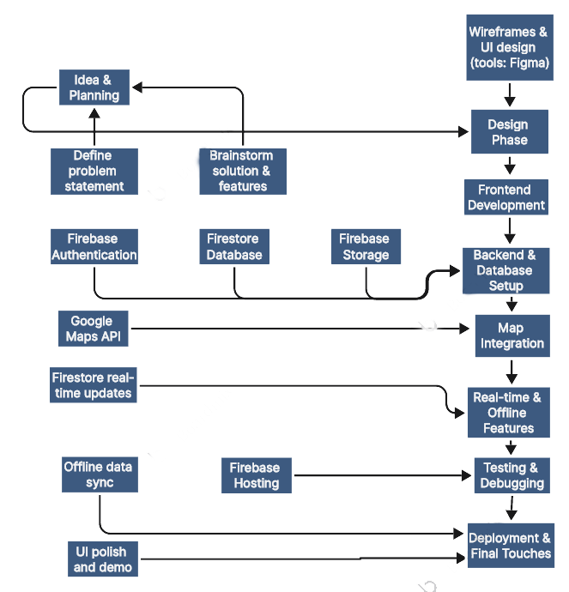
FLOWCHART / DIAGRAM

Slide 5
KEY FEATURES of ReliefNet:
Decentralized Coordination – No central authority; the community organizes itself.
Offline Capability – Works even with poor internet using local storage; syncs when online.
Community Voting – Helps prioritize real-time needs democratically.
Volunteer Matching System – Connects willing locals with NGOs and relief teams.
Gamification – Badges like "Relief Hero" to encourage volunteer participation.
Volunteer Management System – Efficiently organize and coordinate local volunteers..

Slide 6
UNIQUENESS OF PROBLEM :
Faster Aid Delivery – Reduces delays and duplication through better coordination.
Empowered Communities – Enables local participation and accountability.
Scalable Model – Can be used for various rural disasters like floods, droughts, earthquakes, etc.

Slide 7
NOVELTY of ReliefNet :
Community-Driven & Decentralized: Empowers locals to coordinate without relying on a central authority.
Rural-Focused Design: Tailored for low connectivity, low digital literacy, and offline usage.
Real-Time Prioritization: Community voting ensures urgent needs are addressed first.
Volunteer Matching: Connects rural volunteers with NGOs and tasks in real time.
Gamified Participation: Badges and recognition to boost and retain volunteer engagement.
Offline Functionality: Works without internet; syncs later when available.

Slide 8
Possible Limitations/Challenges :
Digital Literacy – Rural users may need initial handholding or training.
Connectivity Issues – Despite offline mode, real-time syncing depends on periodic internet availability.
Data Validation – Fake or exaggerated need reports could affect resource allocation.
Security & Privacy – Protection of user data, especially during emergencies, must be ensured.

Slide 9
Scalability and Future Scope :
Can be extended to:
- Urban slums
- Pandemic response coordination
- Inter-village resource sharing during droughts
Open-source model for community-driven disaster tech globally

Slide 10
PSYCHIC CODERS
Name | Contact
Kumari Shambhavi | Kumarisham.2006@gmail.com
Sumit Kumar | sumitkumar042006@gmail.com
Pritish Kumar | pritishoffical1508@gmail.com
Sweta Raj | sweta4raj.456@gmail.com

Slide 11
Thank you

